Slide 1
Offline mode of SkillAngels Program

Slide 2
Preface
For : Kendriya Vidyalaya Schools
(Grades KG to 8)
Purpose : To setup offline mode in school labs
Approach : Local server will be installed in each lab and the application will be runs from there.

Slide 3
How it works
The application will be loaded in the local server deployed in the school lab.
All the systems in the lab and local server to be connected in same Local Area Network (LAN)
Students will take program using web link or EXE. Student data will be stored in local server.
From the local server, the data will be synchronised to cloud environment, once the internet is connected.
Once data is synchronized, we can add / view that with our cloud database, online.

Slide 4
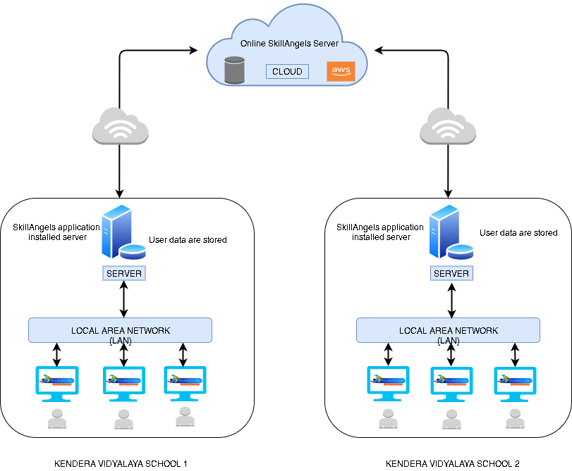
Architecture

Slide 5
Thank you

